Slide 1

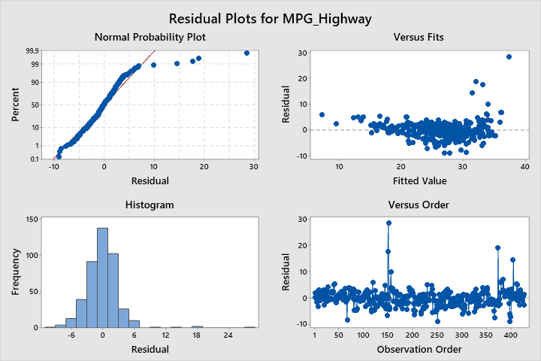
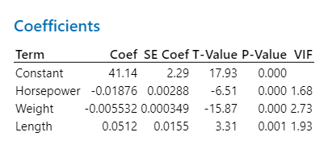
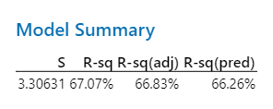
Cars – Regression Analysis
The P values are very small compared to the significance level of 5%. This shows us that these variables play a vital role in the regression analysis.
Sriram Ranganathan
Shanmugapriya V

